Slide 1
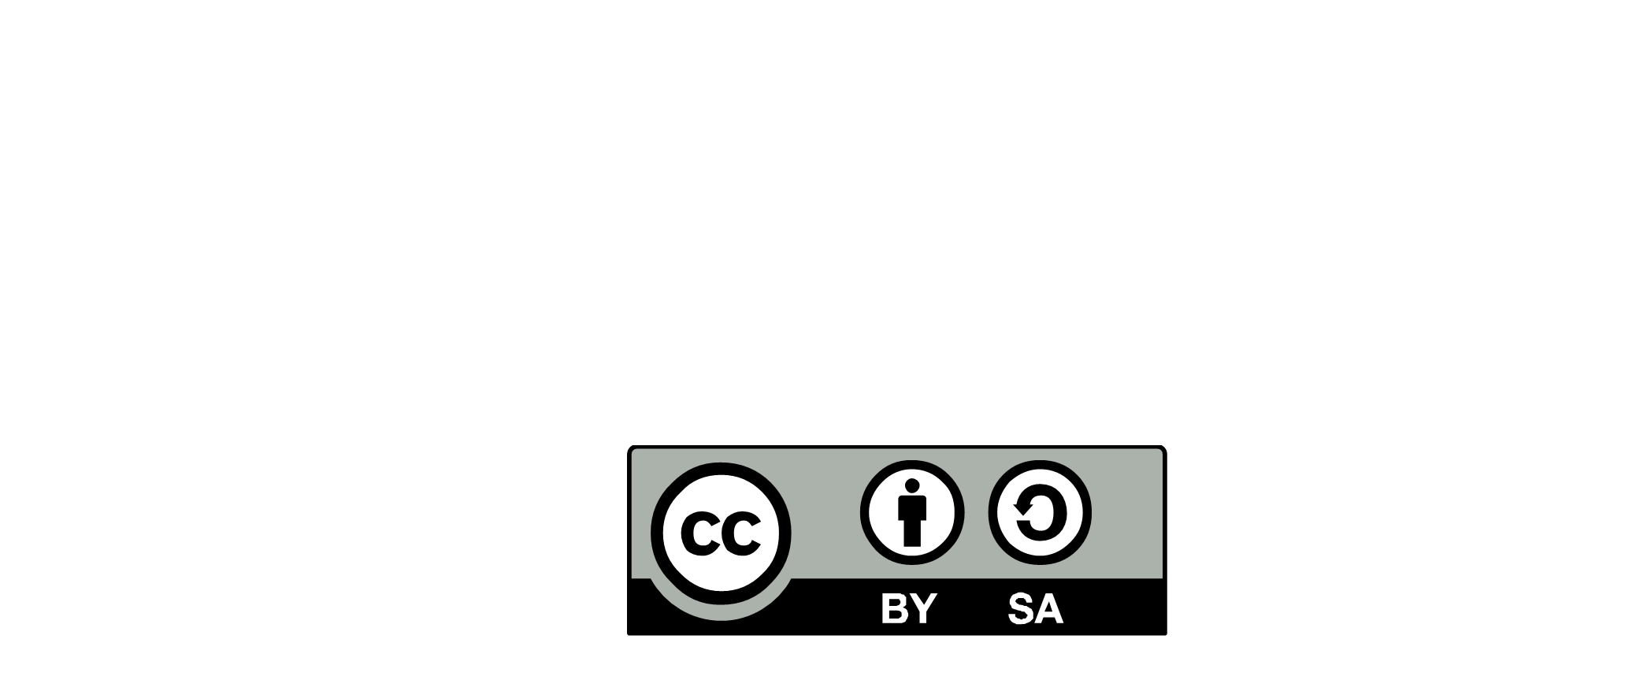
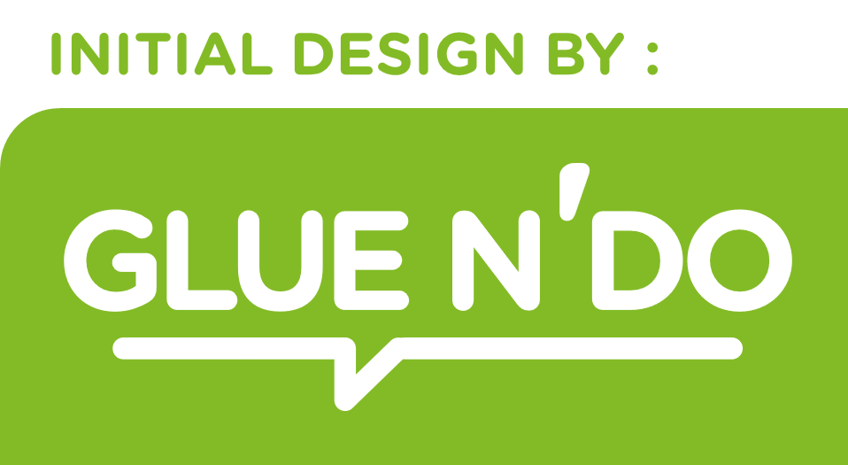
Full stack Product Architecture
Building blocks
Autonomy
USER
RESEARCH
CUSTOMER
RESEARCH
DESIGN THINKING
Kit
VALUE STREAM IMPROVEMENT
PRODUCT
DISCOVERY
EXPERIENCE
DESIGN
JOURNEYS
VALUE STREAMS
&
PROCESSES
STAKEHOLDERS
Kit
IMPACT
MAPPING
Kit
AUTOMATION
APPROACH
CUSTOMER
JOURNEY
OPERATIONS STRATEGY
Kit
Kit
PERSONAE
EXPERIENCE MAPPING
OPERATIONS
ARCHITECTURE
ARCHITECTURE ROLE
OTHER
ROLE
LINKED TO :
VALUE STREAMS
OPERATIONAL
CAPABILITY
Maximize Value for clients & end-user
PRODUCT COMPONENTS
PRODUCT
ARCHITECTURE
Kit
VALUE
CHAIN
EVENT
STORMING
UBIQUITUS
LANGUAGE
ARCHIteCTURE
RUNWAY
DESIGN
STRUCTURE MATRIX
ARCHITECTURE
CONTINUM
Kit
COMPONENT DEPENDENCIES
CONTEXT
MAP
DOMAIN
DRIVEN
DESIGN
VALUE STREAM MAPPING
SOFTWARE
ARCHITECTURE
Kit
Kit
PRODUCT PLATFORM
ARCHITECTURE
PATTERNS
IT PLATFORMS
NUN
FUNCTIONAL
REQUIREMENTS
PROVIDERS
ARCHITECTURE
PRINCIPLES
CRAFTSMANSHIP
ARCHITECTURE
DRIVERS
DEVOPS & SRE
ARCHI
ARCHIMATE
Kit
ARCHITECTURE
OVERVIEW
COMMUNICATION
SECURITY
RISK
IMPACT
MAPPING
SITE
REFERENCE ARCHITECTURE
Explain and
promote
Simple
For the audience(s)
ROADMAP
End to end integration
Mutual requirements
Migration strategy
Scale up
Technical debt
PROBLEM
DESCRIPTION
ARCHITECTURE
VISION
ARCHITECTURE
DECISION
OPERABILITY
RISK
Make the right decision and document it
Rational
Transparence
Source: O-AA™ Standard
BUSINESS
AMIBITIONS
Kit
ARCHITECTURE
DECISION
RECORD
CONTINUOUS ARCHITECTURE DELIVERABLES
-2020.2 -

